Slide 1

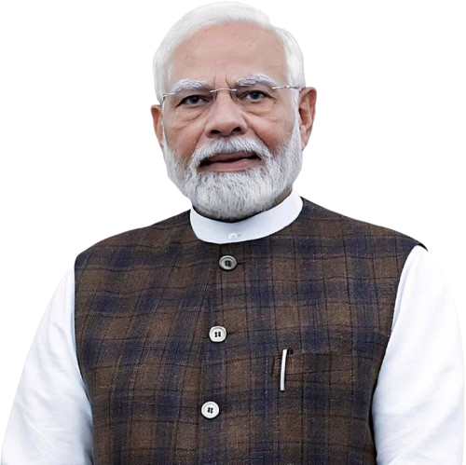

PM Internship Scheme
Pilot Project Round III
State - Haryana

Slide 2




Prime Minister Internship Scheme (Pilot Round III)
The Prime Minister Internship Scheme was announced in the Budget 2024-25 with the aim of providing internship opportunities to 1 crore youth, in Top Companies in 5 years. Through this Scheme, youth will gain exposure to real-life business environment, across varied professions and employment opportunities. Currently, Pilot Round 3 is now live for the youth to participate.
Benefits of PM Internship Scheme Pilot Round III
6 or 9 months real life experience in top Companies of India
Monthly Financial allowance of ₹9000 with One time grant of ₹6000 for incidentals, pay in 2 equal Instalments
Insurance coverage under Pradhan Mantri Jeevan Jyoti Bima Yojana and Pradhan Mantri Suraksha Bima Yojana.
Learn and grow with the top companies of India. Networking opportunity with Industry professionals.
Notes:
CSR Expenditure in companies

Slide 3
Detailed Candidates’ Eligibility criteria (PMIS Pilot Round III)
01
Youth aged between 18 and 25, as on the date of application submission, who are not employed full time
Candidates who have passed High School, Higher Secondary School, possess a certificate from an ITI, hold a diploma from a Polytechnic Institute, or are undergraduates with degrees such as BA, B.Sc., B.Com, BCA, BBA, B.Pharma, B.E./B.Tech etc. or postgraduates with degrees such MA, M.Sc., M.Com, MCA, M.Tech etc. are eligible to apply
02
03
Candidates must not be engaged in full-time education. However, candidates enrolled in online or distance learning programs or candidates enrolled in the final year of full-time graduation or post-graduation are eligible to apply.
04
Must not be graduates/postgraduates from IITs, IIMs, National Law Universities, IISER, NIDs, IIITs and IISc, and must not hold professional qualifications such as CA, CMA, CS, MBBS, BDS, MBA, or PhD
05
Those undergoing any skill, apprenticeship, internship or training program under Central Government or State Government schemes are not eligible
06
Those who have completed apprenticeship, training under (NATS) or (NAPS) at any point are not eligible
07
Income of any family member must not exceed ₹12 lakh in the preceding financial year as on the date of application submission.
08
No family member should be a permanent/regular government employee (family includes self, spouse and parents).

Slide 4
Companies Eligibility Criteria - PMIS Pilot Round III
As per clause 5.3 of PMIS Guidelines Criteria for the companies (Partner Companies) to participate
Category A
Category B
353 Companies participated in the previous rounds and Top 2,000 companies as per average CSR during the last three financial years are eligible to participate and,
Companies with CSR Expenditure in each of the Last 3 Financial Years (FY 2024-25, FY 2023-24, and FY 2022-23), are eligible (subject to MCA approval) if they meet any one of these sub criteria:
  Turnover >= 1000 crore, or
  Net worth >= 500 crore, or
Companies from under‑represented sector
Internship opportunities must not exceed 15% of the company’s total workforce.
Minimum number of Internships: 50
Reference lists available on PMIS Portal (Guidelines Section)
Additionally, following companies/organizations are also eligible subject to MCA approval:
Professional Associations/Institutions (e.g., ICAI, ICSI, ICMAI)
Selected MSMEs through Sectoral Associations
Global Capability Centres (GCCs)
Special Economic Zones (SEZs)
Companies nominated by State Governments/Union Territories (up to 20 companies)
Statutory Authorities such as AAI, Shipping Corporation of India etc.

Slide 5





Value Proposition for Partner Companies
A Strategic Win-Win for Talent, Growth & Impact. An opportunity to contribute to nation-building
Access to High Quality Talent Pool
Cost-Effective Talent Development
Flexibility & Industry-Led Design
Scalable & Structured Execution
Strategic Business & CSR Impact
    Pan‑India access to diverse interns
    Government co-funding of stipends reduces hiring cost
    No fixed curriculum – design programs as per business needs
    PMIS platform offers end-to-end program management
    Deliver on CSR + Talent + Growth agendas simultaneously
    Reach talent beyond metros → district-level sourcing
    Lower spend on recruitment, training & onboarding
    Align internships with roles, projects, and workflows
    Built-in monitoring, governance & grievance mechanisms
    Strengthen supply chain and workforce ecosystem
    Build a future-ready talent pipeline
    “Test-before-hire” model for better conversion outcomes
    Support project-based & operational workforce flexibility
    Demand-driven, scalable internship model
    Enhance employer branding & national visibility

Slide 6
Onboarding Process as PMIS Partner Company

Slide 7

Onboarding Procedure
EOI for
Top 2000
EOI for Other Eligible Companies
Step 1
Expression of Interest Submission
Step 2
Evaluation of EOI
Step 3
Approval and Onboarding
    Submit EOI to initiate onboarding
    Eligible companies receive EOI via email.
    If not received → request at: pmisindustrysupport@mca.gov.in
    Refer to PMIS Portal (Guidelines Section) for lists
    PMIS Cell reviews submission for completeness, correctness and adherence to PMIS guidelines. EOI must be complete and accurate, covering:
    Section A: Company Details
    Section B: Eligibility Declaration (CSR/Turnover/Net Worth)
    Section C: Internship Commitment
    Section D: Internship Requirement Plan
    Section E: Implementation Framework
    Section F: Key Contacts
    Company Admin; Nodal Officer; PMIS SPOC
    Section G: Approval Letter (Mandatory)
    Final review by Ministry of Corporate Affairs
    Assessment of eligibility & completeness
    Formal approval for onboarding
    Post-approval Activation & Onboarding Support
    Portal login credentials shared with Company Admin
    WhatsApp group onboarding by PMIS Cell
    Capacity building & onboarding sessions for companies
Upon submission of EOI, it typically takes 7 days to onboard as PMIS Partner Company, provided the EOI is complete.

Slide 8
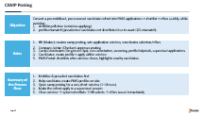
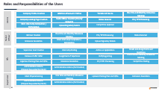
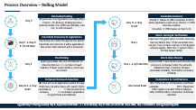
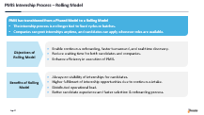
Operational Modalities for Partner Companies
Structured access for seamless operations. Clear role definition for efficient coordination & execution. 4 user roles:
Company Admin
Nodal Officer
HR
Supervisor
Dedicated Company Users on PMIS Portal
PMIS Portal enables end-to-end lifecycle:
Posting → Selection → Joining → Tracking → Completion
Company-led internship lifecycle. Managed primarily by HR user. Two modes of posting:
Regular (Rolling basis)
Camp-based drives
Built-in monitoring, dashboards & grievance support
Internship Posting & Management
Internship Commitment & Scale
Minimum commitment: 50 internships
Maximum cap: Up to 15% of workforce (including both regular and contractual staff on its payroll)
Flexibility to extend via group companies / supply chain partners

Slide 9
State Nominated Companies & MSME

Slide 10

State-Nominated Companies: Enabling Localized and Demand-Driven PMIS Participation
States/UTs may nominate up to 20 suitable companies for consideration under PMIS Category B(v), enabling inclusion of credible local employers from strategic, emerging, underrepresented, and regionally relevant sectors.
Why State Nomination?
Who Can Be Nominated?
What Information is Required?
To move beyond centrally identified companies and enable States/UTs to bring credible local employers into the PMIS ecosystem and widen PMIS participation by bringing in companies that are:
Locally relevant to State/UT economic priorities
Aligned with district-level industry demand
Present in emerging, growth, or underrepresented sectors
Capable of offering meaningful workplace exposure to youth.
States/UTs may prioritize companies based on:
Credibility and operational scale
Capacity to offer defined internship roles, mentoring and supervision
Alignment with local youth employability and skill levels
Presence in Tier 2/3 cities, industrial districts and aspirational districts
Relevance to MSME clusters and local enterprise ecosystems
No ongoing enforcement action or regulatory restriction impacting suitability
For each nominated company, States/UTs will provide key details including:
Company name, CIN, district and sector
Company category: Large / MSME / Startup / Service / Cluster Unit
Employee strength and proposed internship capacity
Proposed internship roles and locations
Justification for nomination
MCA-facing SPOC details
Completed Expression of Interest form as per Annexure I
Notes:
Speaker - Domela

Slide 11
MSME
What is the Model?
MSMEs to be onboarded through Sectoral Associations (Category B(ii))
Enables cluster-based aggregation of internship opportunities via association for constituent units
Reduces onboarding burden on individual MSMEs
Designed to expand localized and sector-specific internships
Onboarding Flow
Identify credible sectoral associations with strong MSME base
Sectoral Association submits EOI to MCA, highlighting aggregation from eligible MSME units
MCA evaluates of scale, credibility, and implementation capability and onboards
MSMEs post opportunities & onboard interns via PMIS portal
Support Needed from State/UT
Identify & recommend strong sectoral associations/clusters and facilitate outreach and enable coordination to MSME network. The selected MSME must:
be operational and capable of hosting interns
Provide structured, real workplace exposure
Meet internship commitment: Lower of 50 interns OR 15% of workforce
Notes:
Speaker - Domela

Slide 12
PMIS Round I, Round II and Round III Sector-wise Supply Status: Haryana State
The sector-wise application trends across Rounds I, II and the ongoing Round III indicate sustained interest from Haryana youth in PMIS opportunities. Automotive, Oil & Gas/Energy, Travel & Hospitality, Telecom, Manufacturing, and IT & Software Development have consistently attracted the highest number of applications, reflecting strong alignment with Haryana's industrial ecosystem and youth career aspirations.
Leverage Haryana's extensive network of universities, colleges, ITIs, polytechnics, district administrations, employment exchanges, and industry associations to drive awareness and mobilization, particularly for sectors witnessing lower application volumes, while sustaining momentum in high-demand sectors. This will help maximize candidate participation and ensure balanced sectoral representation under PMIS.

Slide 13
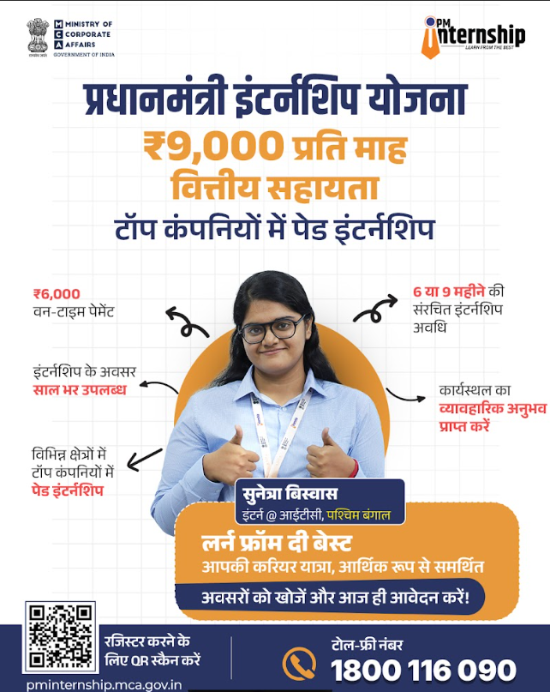
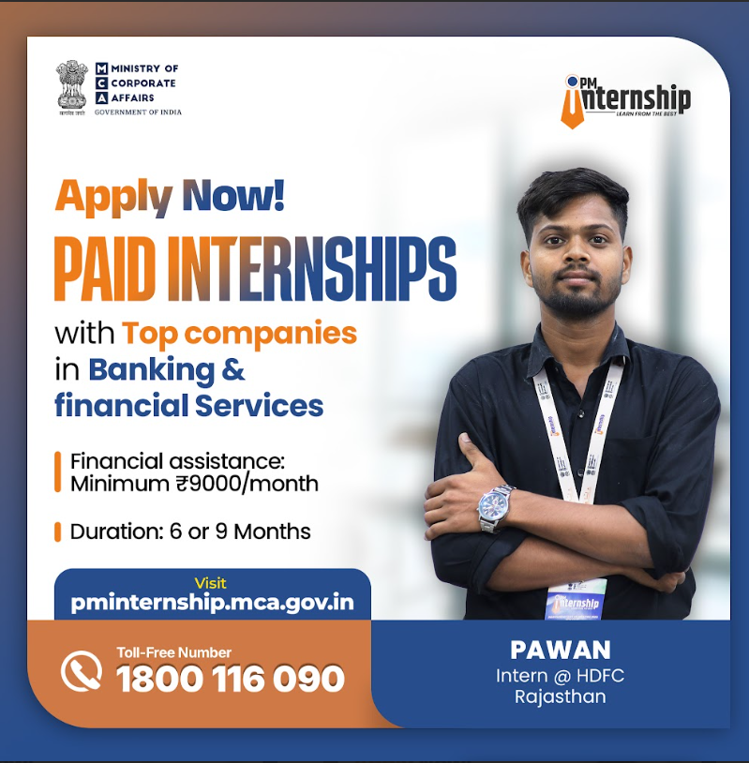

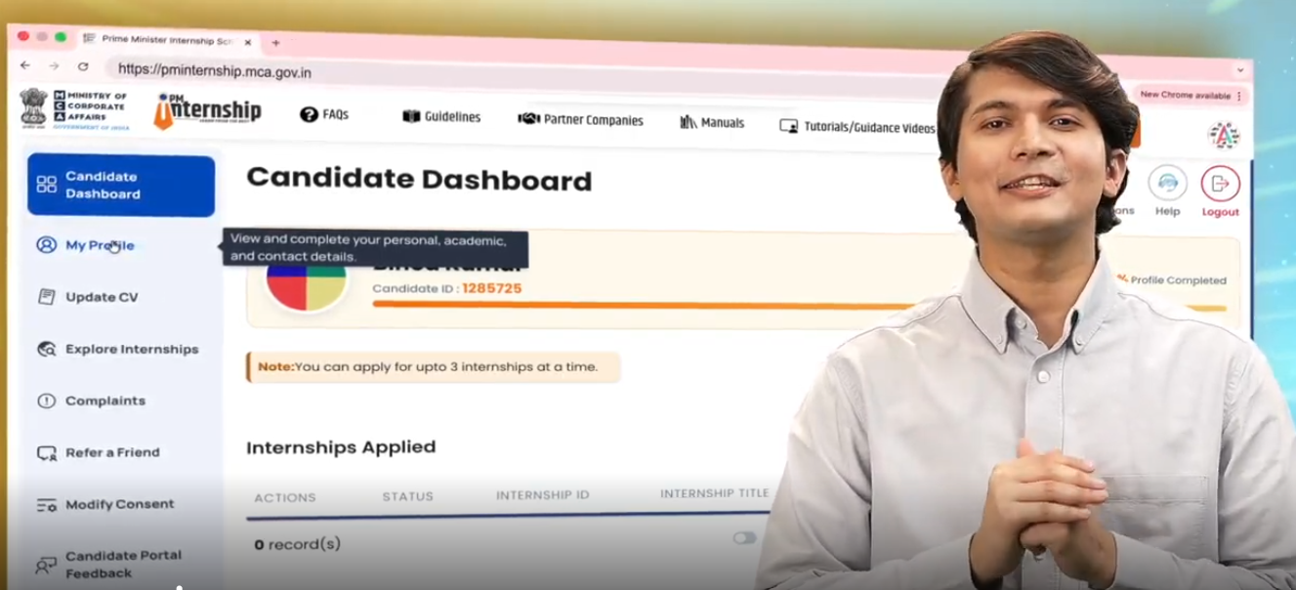
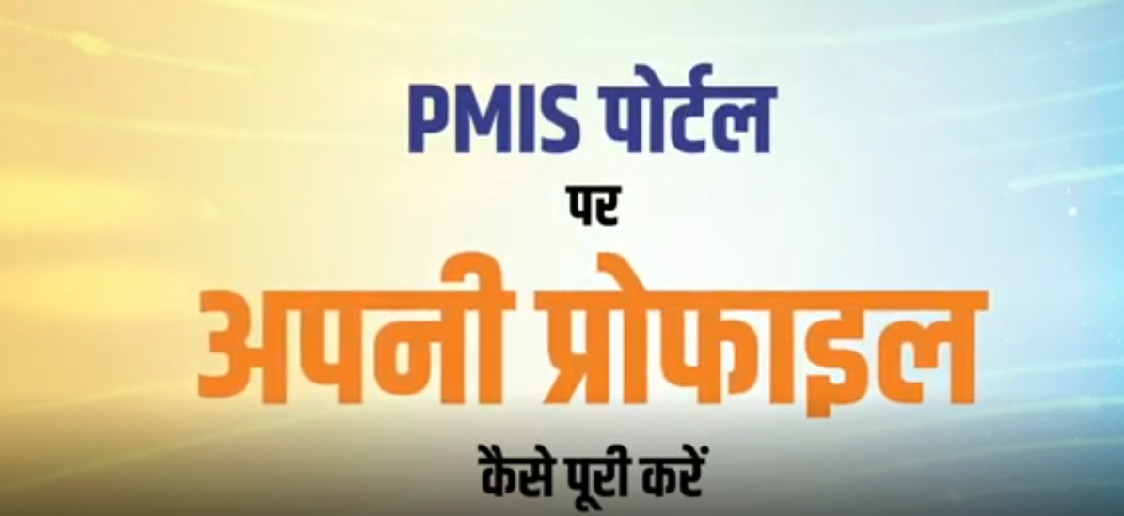
State IEC Collaterals - PMIS Pilot Round III
Scheme Infographics
Sector-wise Infographics
Candidate Testimonial
Portal Tutorials
Link to access the State IEC Collaterals for PMIS Pilot Round III:
https://drive.google.com/drive/folders/1XYa9Ul4KaREI4auFHdOqQWk17HQtFrue?usp=sharing)
Notes:
Speaker - Vipul

Slide 14
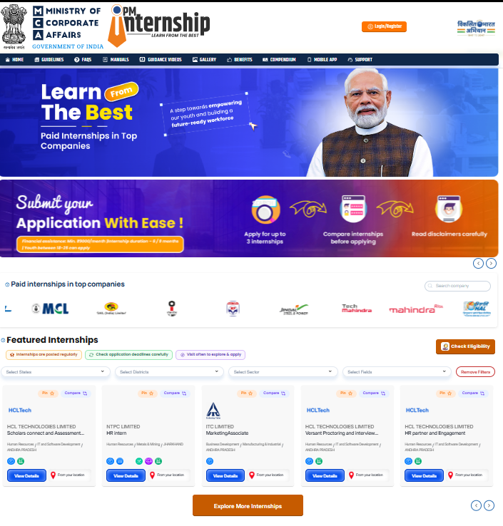
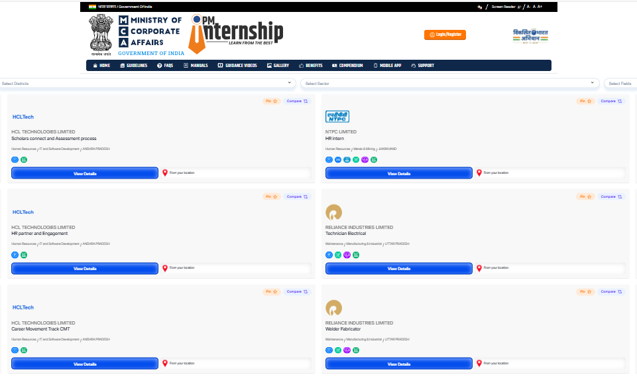
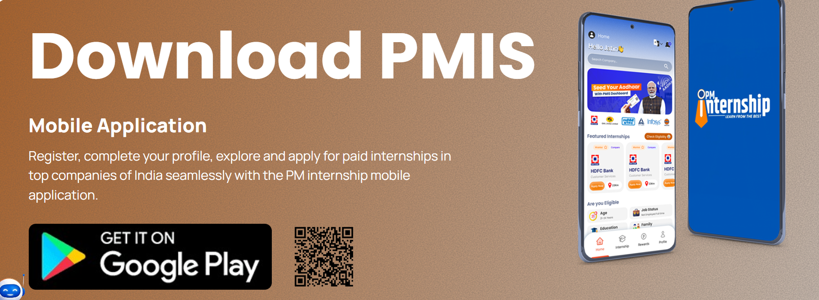
PMIS portal - www.pminternship.mca.gov.in

Slide 15
Thank You

Slide 16
Roles and Responsibilities of the Users
Company Profile Creation
Addition of Network Entities
Transfer of Interns
One time and Monthly Allowance Marking
Admin
Company Landing Page Creation
Nodal Officer Creation (Parent/ Network)
Status Reversal
PO / PPO Processing
Mark Internship Completion / Participation
Upload Signatory Details
Camp Drive Approval
Nodal Officer
HR User Creation
One time and Monthly Allowance Marking
PO / PPO Processing
Status Reversal
Grievance Resolution
Mark Internship Completion / Participation
Upload Signatory Details
Supervisor User Creation
Internship Posting
Action on Applications
Create and Assign Terms and Conditions
HR
Release of offer letter
Assignment of Supervisor
Verifying joining
One time and Monthly Allowance Marking
Approves Training Plan and QPRs
Grievance Resolution
PO / PPO Processing
Camp Drive Posting
Administrative Actions
(Dropout Requested by Intern)
Administrative Actions (Termination)
Mark Physical Joining
One time and Monthly Allowance Marking
Uploads Training Plan and QPRs
Grievance Resolution
Supervisor
Administrative Actions
(Dropout Requested by Intern)
Administrative Actions (Termination)

Slide 17
PMIS Internship Process – Rolling Model
PMIS has transitioned from a Phased Model to a Rolling Model
The internship process is no longer tied to fixed cycles or batches.
Companies can post internships anytime, and candidates can apply whenever roles are available.
Objectives of Rolling Model
Enable continuous onboarding, faster turnaround, and real-time discovery.
Reduce waiting time for both candidates and companies.
Enhance efficiency in execution of PMIS.
Benefits of Rolling Model
Always-on visibility of internships for candidates.
Higher fulfilment of internship opportunities due to continuous intake.
Distributed operational load.
Better candidate experience and faster selection & onboarding process.

Slide 18
Process Overview – Rolling Model
Internship Posting
Candidate Decision
Day P
HR posts and sets Application End Date (Day E = Day 0 + 15–30 days). Posting becomes instantly visible. Only drafts are editable; once live, no edits allowed.
Day O → Day O+14
Accept ➡ Moves to Offer Accepted; all other active applications auto‑close. Decline ➡ Offer becomes inactive.
No action ➡ Offer lapses on Day O+15.
Intern Joining & Verification
Candidate Discovery & Application
Supervisor may grant up to 1‑month extension, but only before Day J. If the candidate does not join / has not been marked, a 14‑day grace window applies. After this ➡ system marks Did Not Report (DNR).
Day P → Day E
E: 15-30 days
Internships are visible throughout this period. Candidate can have max 3 active applications. Non-exact match allowed with a disclaimer.
Day J
Shortlisting
Internship Lifecycle
Day E
System generates only one shortlist per IO. Max shortlist size = 2 × number of exact matches. If fewer exact matches, only those are shared.
Day J → 6/9 Months
One-time DBT in two tranche and Monthly DBT process is unchanged other the amounts; Sabbatical (max 2 months); Dropout (candidate initiated); Termination (company initiated)
Company Review & Selection
Completion & Certifications
Day E+1 → Day E+45
HR must act on all applications within 45 days. If HR does not act by Day E+45, system marks candidate as: ➡ Not considered by company ➡ Candidate’s application slot gets freed automatically.
Internship Ends
After 50% duration: Participation Certificate available PPO / Placement Offer eligible only after 50% completion After 100% duration: Completion Certificate available
Legend: Day P: Posting created; Day E: Application End Date = S + 15 to 30 days; Day O: Date on which HR issues offer; Day J: Candidate’s joining/reporting date

Slide 19
CAMP Posting
Objective
Convert a pre-mobilized, pre-screened candidate cohort into PMIS applications + shortlist + offers quickly, while avoiding:
shortlist pollution (outsiders applying)
profile mismatch (preselected candidates not shortlisted due to exact QCS mismatch)
Roles
HR (Maker): creates camp posting, sets application window, coordinates selection/offers
Company Admin (Checker): approves posting
Camp Coordinator (On-ground Ops): runs orientation, screening, profile helpdesk, supervised applications
Candidates: create profile + apply within window
PMIS Portal: shortlists after window closes, highlights nearby candidates
Summary of the Process Flow
Mobilize & preselect candidates first
Help candidates create PMIS profiles on-site
Open camp posting for a very short window (1–4 hours)
Make the cohort apply in a supervised session
Close window → system shortlists → HR selects → offers issued immediately

Slide 20

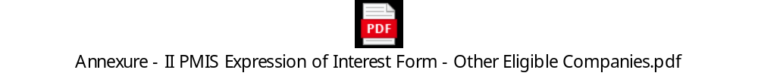
Annexures
Annexures I: Expression of Interest Form – For Top 2000 Companies as per Avg CSR
Annexure II: Expression of Interest Form – For companies Eligible as per other criteria

